Slide 1
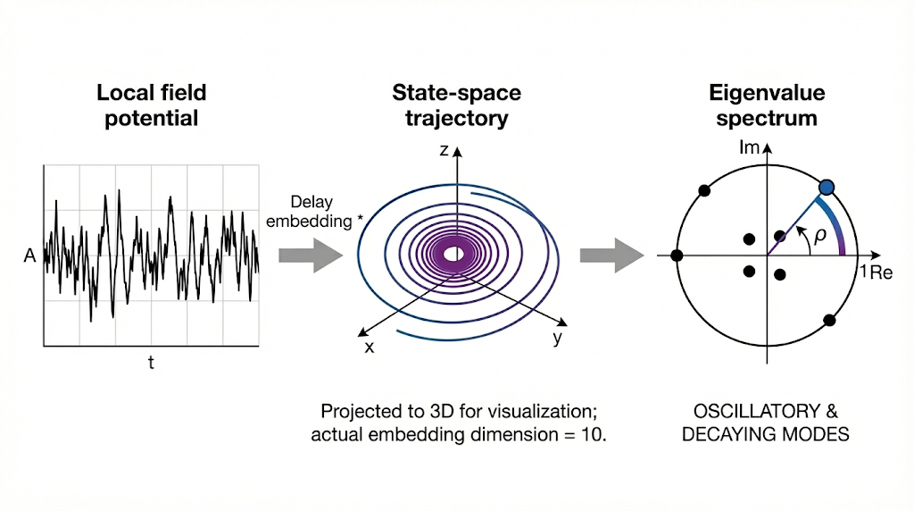
Figure 1 | Quantifying rotational dynamics in human cortical activity.
a, Schematic of the analysis pipeline. Local field potentials (or source-reconstructed MEG time series) are transformed into state-space trajectories via time-delay embedding (delay d=1). While the trajectory is projected here into 3 dimensions for visualization, the analysis utilizes a 10-dimensional state space. A linear model is fitted to the trajectory, and the resulting eigenvalues (lambda) are plotted on the complex plane. The rotational dynamics index (rho) is calculated based on the imaginary component of these eigenvalues (visualized as the angle relative to the real axis), where high rho indicates sustained oscillatory rotation and low rho indicates rapid decay.

Slide 2
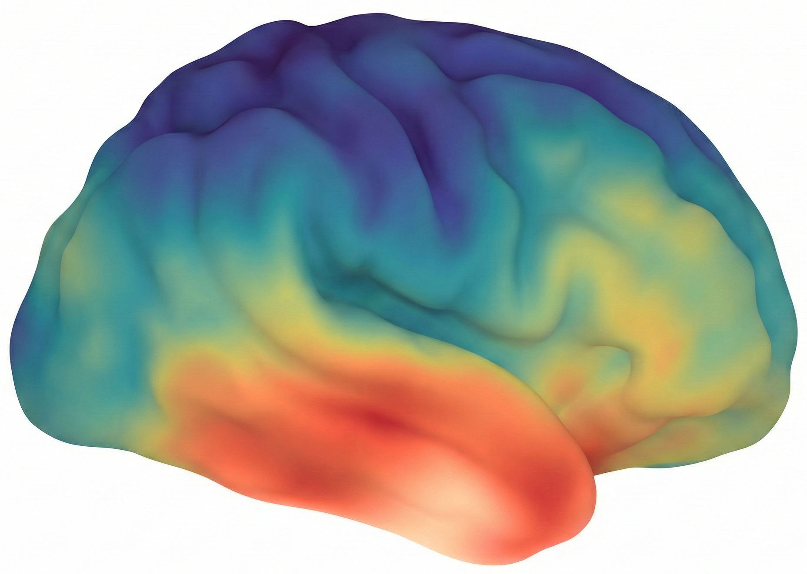
High $\rho$ (Ventral)
Low $\rho$ (Dorsal)
b, Cortical surface map of the rotational dynamics index (rho) across 400 parcels. The map reveals a pronounced dorsoventral gradient: ventral regions (temporal, orbitofrontal; warm colors) exhibit high rho, indicating strong rotational dynamics, while dorsal regions (parietal, superior frontal; cool colors) exhibit low rho, indicating overdamped dynamics.

Slide 3
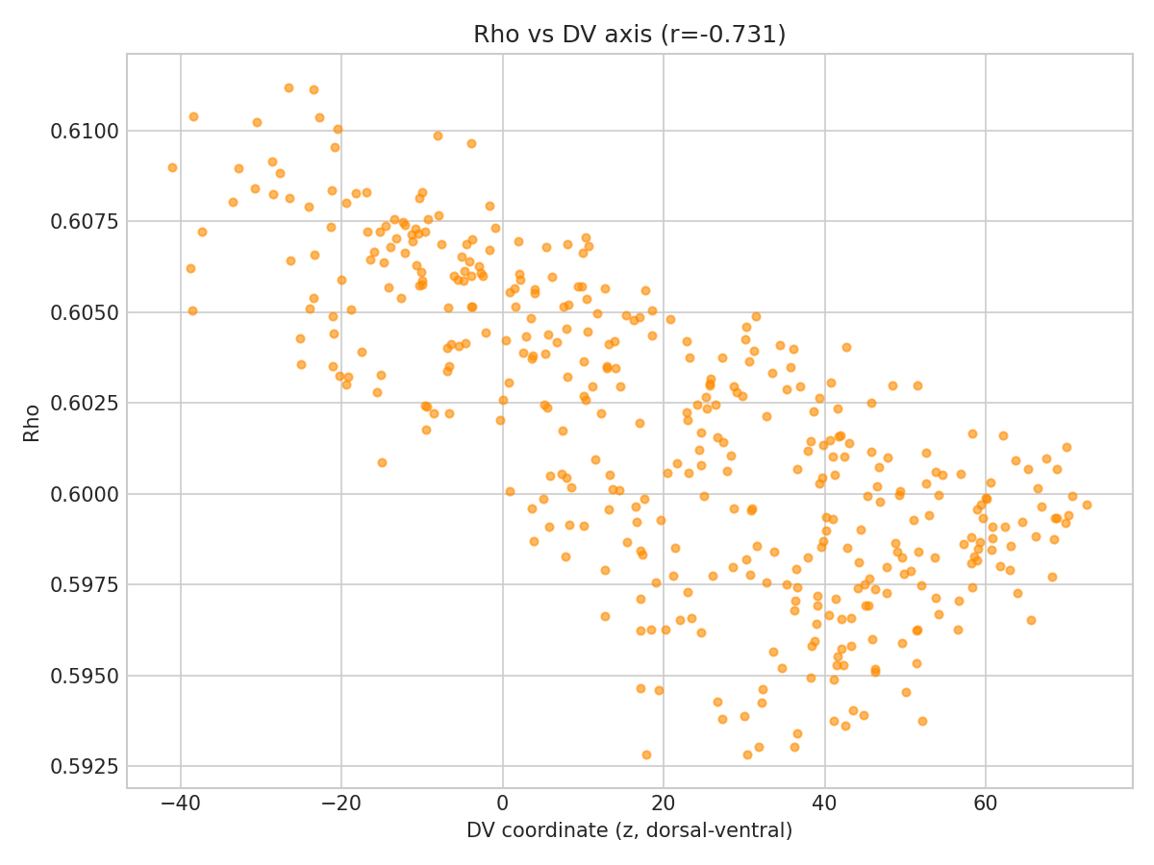
c, Scatter plot showing the strong negative correlation between the anatomical Z-coordinate (ventral-to-dorsal position) and rotational dynamics (rho) across all cortical parcels (r = -0.735, p_{spin} = 0.002). Each dot represents one parcel. The gradient is robust to parcellation resolution and independent of the principal functional connectivity gradient. The black line represents the linear regression fit; shaded area indicates the 95% confidence interval.

Slide 4
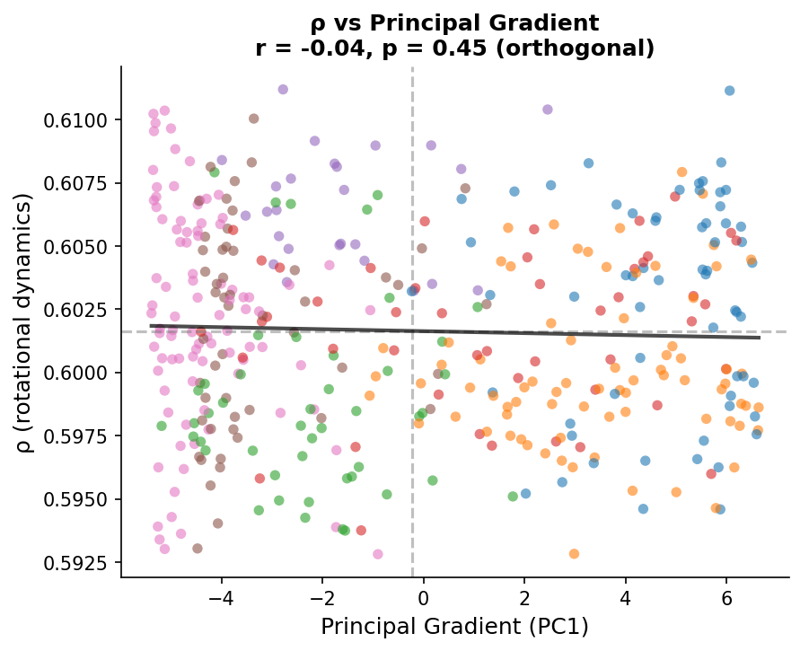
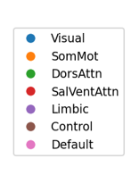

Slide 5
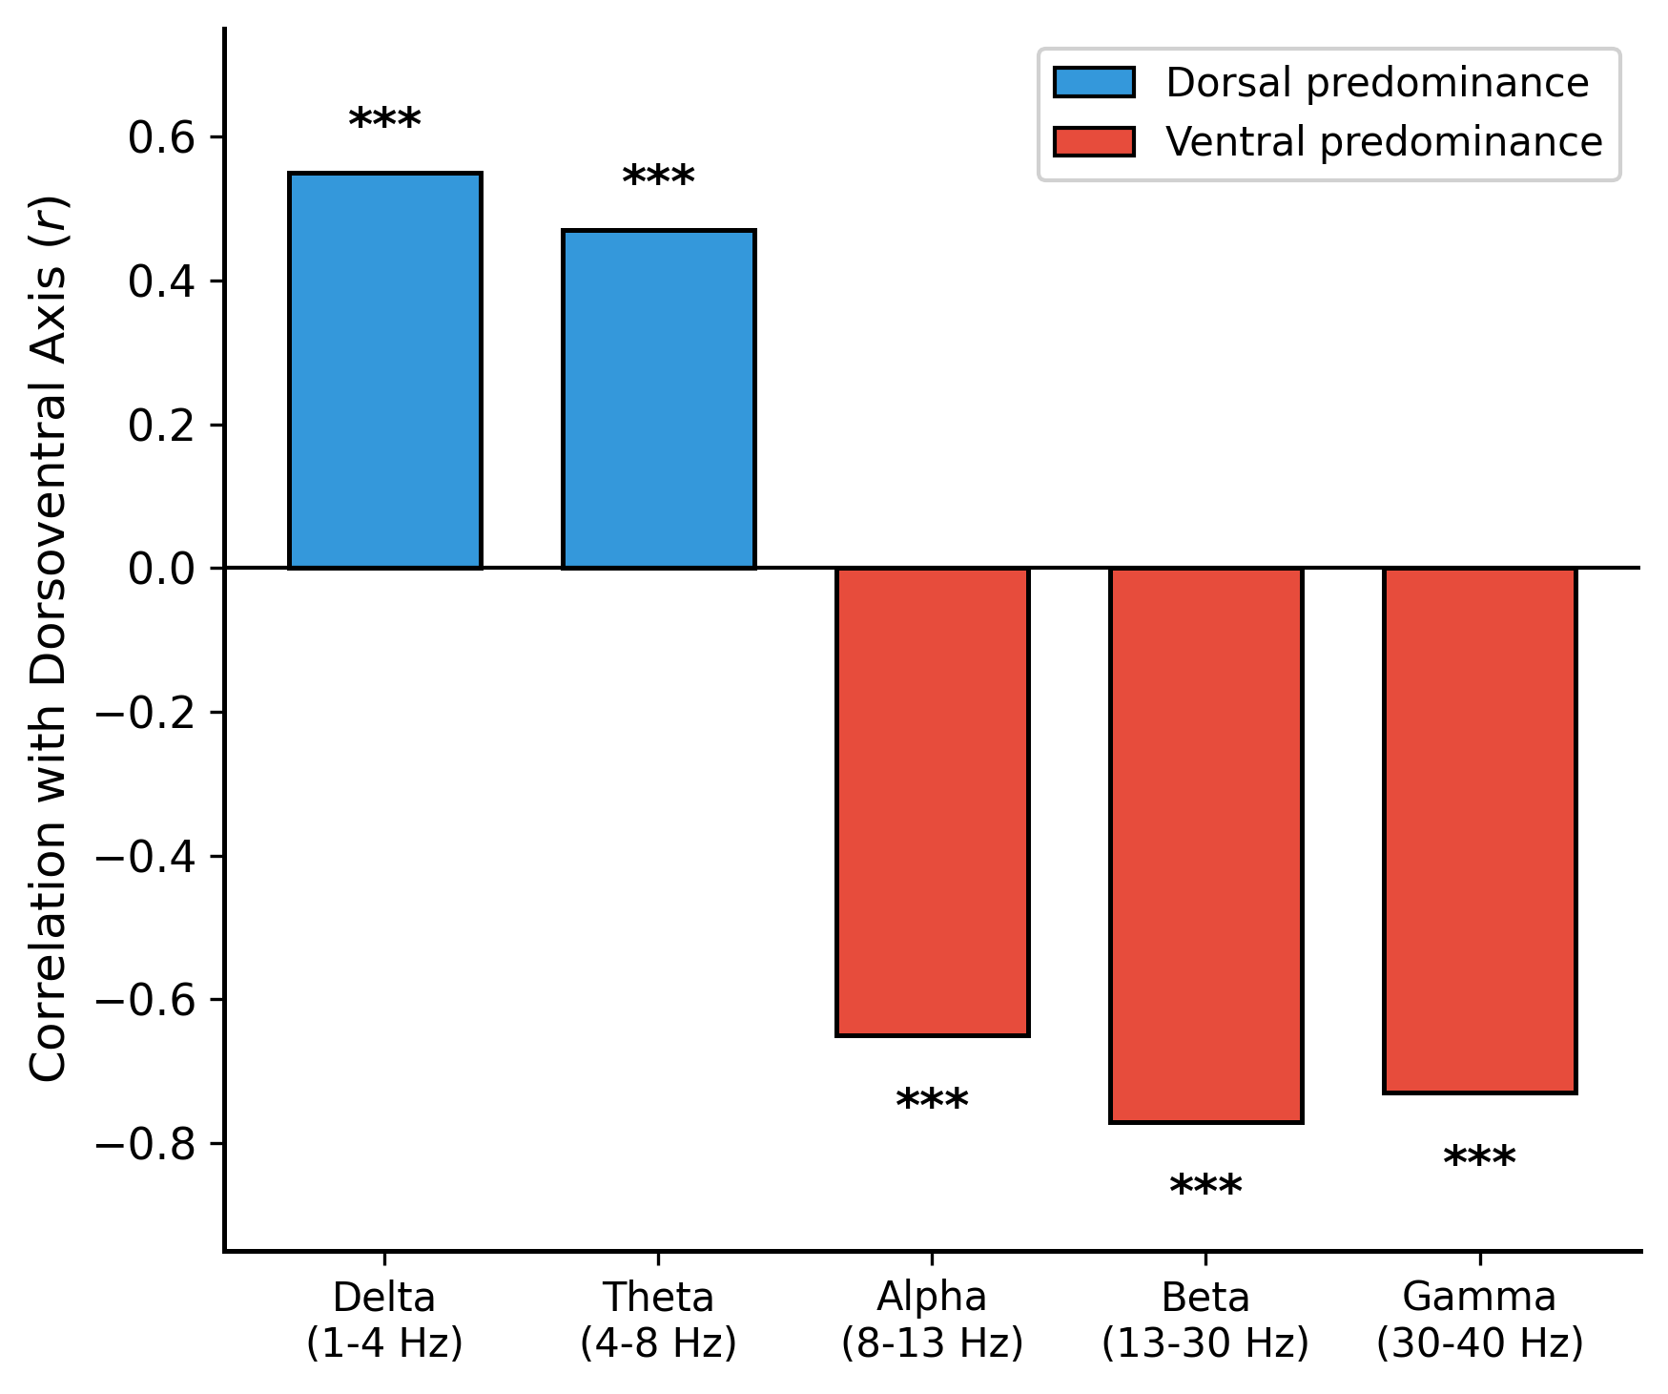
Figure 2 | Frequency-specific organization reveals a spectral trade-off.
a, Correlation between rotational dynamics ($\rho$) and the dorsoventral axis across canonical frequency bands. Slow rhythms (delta, theta) show positive correlations (dorsal predominance, blue), while fast rhythms (alpha through gamma) show negative correlations (ventral predominance, red).
b, This spectral trade-off is robust to methodology. Comparison of gradients derived from fixed embedding delays (solid) versus adaptive delays targeting a quarter-cycle phase advance (hatched) reveals nearly identical spatial organization.
c, Cortical surface visualizations of the spectral shift. Delta band dynamics (left) are strongest in dorsal parietal/motor regions, whereas gamma band dynamics (right) are strongest in ventral temporal/orbitofrontal regions.

Slide 6
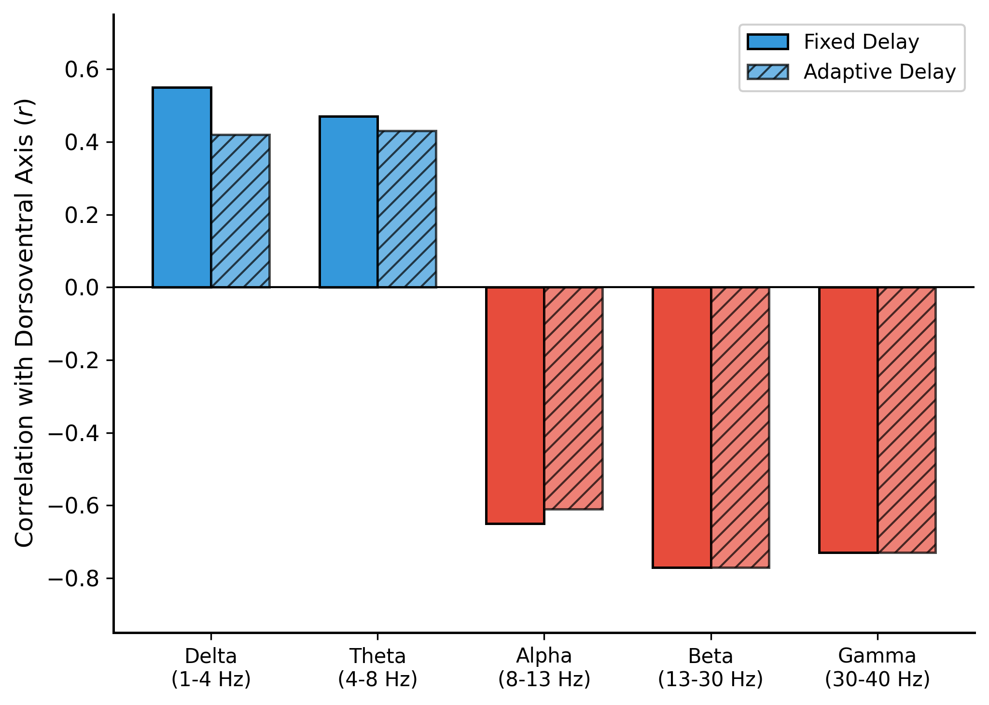

Slide 7
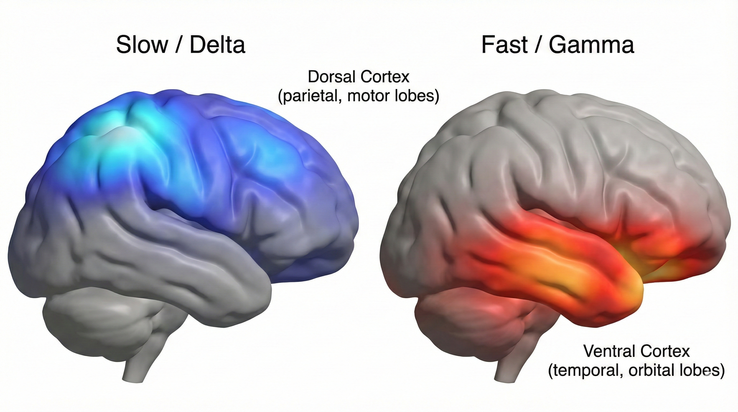

Slide 8
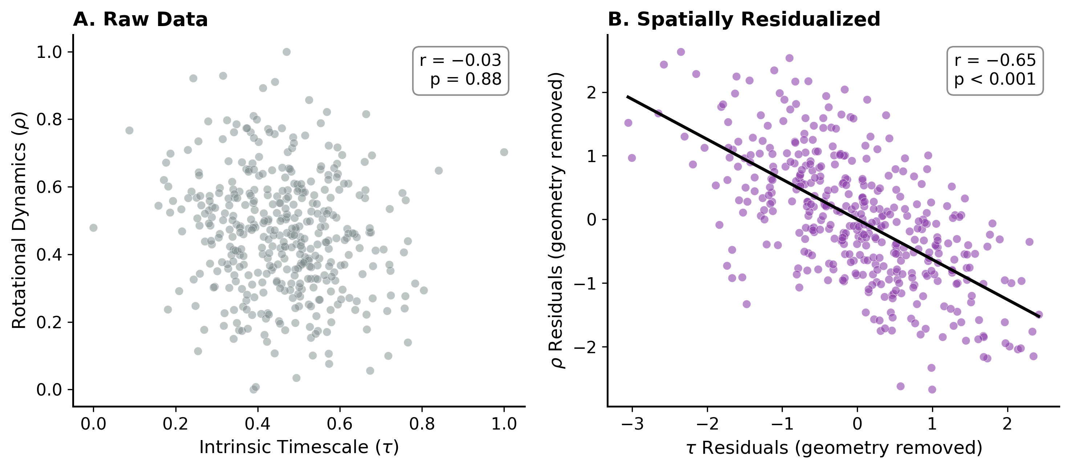
Figure 3 | Dissociation from intrinsic timescales and cross-modal validation in fMRI.
a, Relationship between intrinsic timescales ($\tau$, autocorrelation window) and rotational dynamics ($\rho$) across parcels. In raw anatomical space, the two metrics appear independent ($r = -0.034$, $p_{spin} = 0.88$), indicating distinct spatial topographies.
b, After regressing out spatial coordinates ($x, y, z$) to remove gross anatomical gradients, a strong anticorrelation emerges between $\tau$ and $\rho$ residuals ($r = -0.647$, $p_{spin} = 0.0002$). This suggests a local circuit trade-off: regions cannot simultaneously maximize temporal integration (long $\tau$) and oscillatory rotation (high $\rho$).
c, Cross-modal validation in resting-state fMRI (MOUS dataset, $N = 200$). Despite the slower temporal resolution of BOLD signals, the dorsoventral gradient of rotational dynamics is replicated ($r = -0.246$, $p_{spin} < 0.001$).
d, Independent replication in the Human Connectome Project (HCP, $N = 1,093$). Using broadly filtered task-state fMRI (0.009–0.25 Hz), the dorsoventral gradient is robustly detected ($r = -0.124$, $p_{spin} = 0.014$), confirming generalizability across scanners and acquisition protocols.

Slide 9
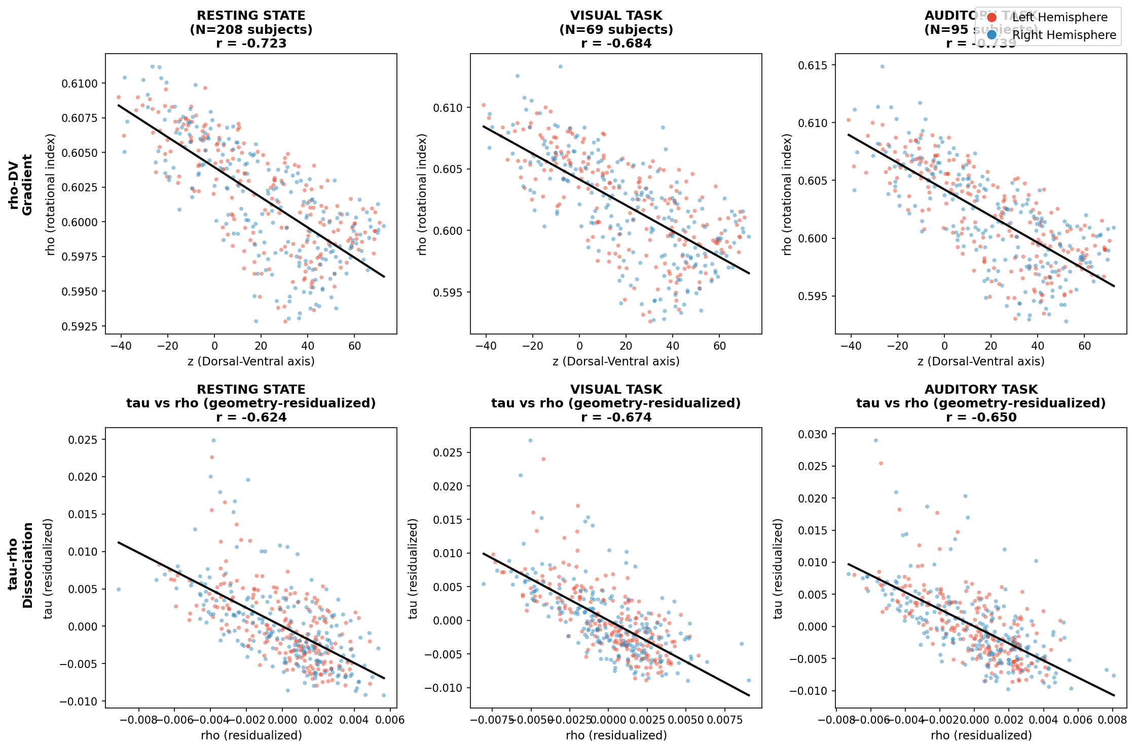

Slide 10
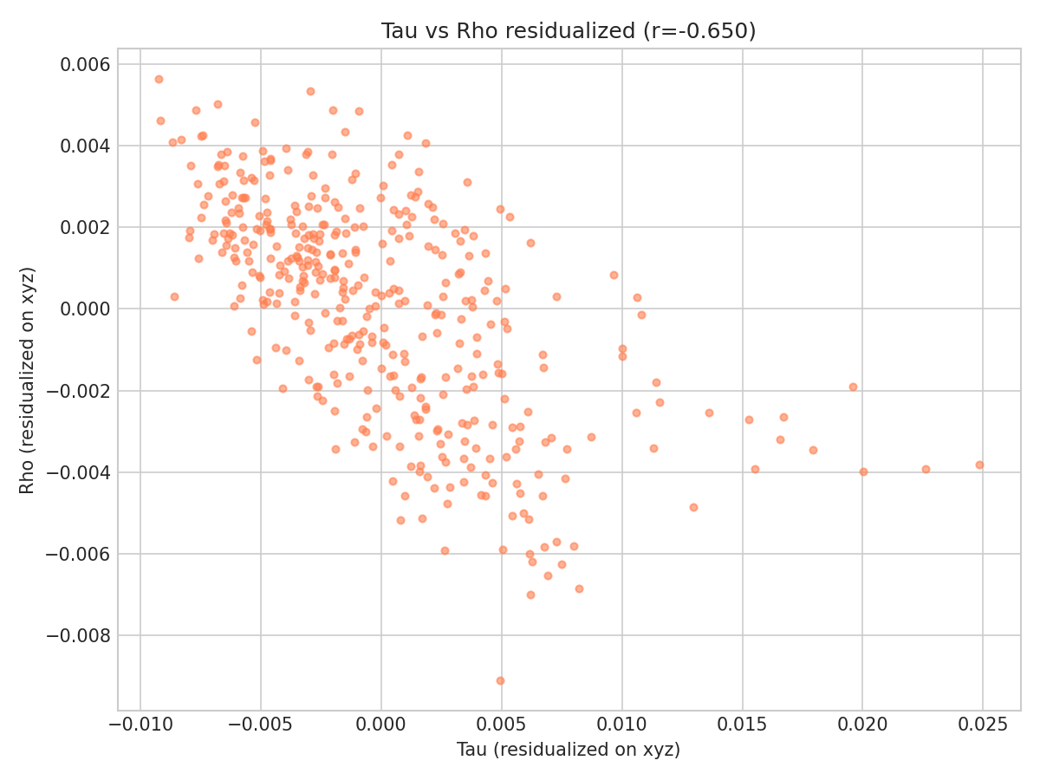

Slide 11
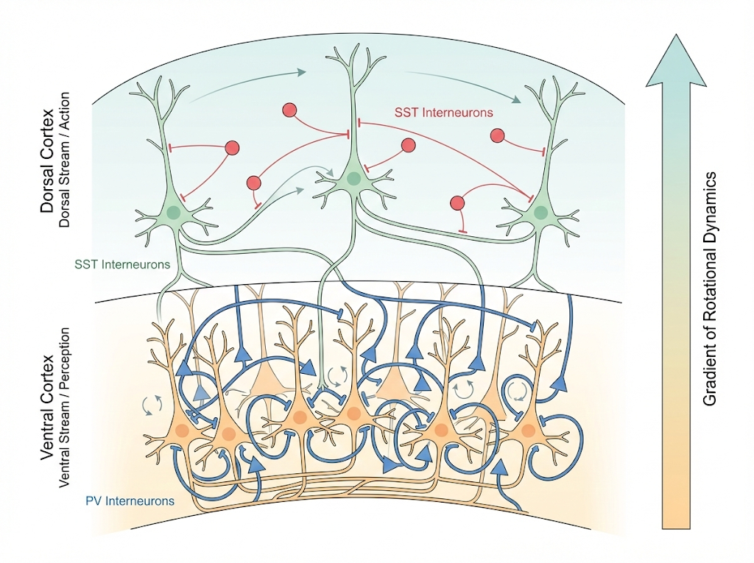
Figure 4 | Putative circuit mechanisms and functional implications of the dorsoventral dynamical gradient.a, Hypothesized gradient of inhibitory interneuron dominance. Ventral regions (high $\rho$) may be dominated by parvalbumin-positive (PV) interneurons, which provide perisomatic inhibition and generate fast gamma oscillations favorable for rotational dynamics. Conversely, dorsal regions (low $\rho$) may rely more on somatostatin-positive (SST) interneurons (dendritic inhibition) and long-range loops that favor slow integration and stable, decaying dynamics.b, Alignment with the "dual-stream" model of cortical processing. The gradient of rotational dynamics parallels the functional distinction between the ventral "what" stream (requiring dynamic binding of features over time; high $\rho$) and the dorsal "where/how" stream (requiring stable spatial coordinates and point-attractor dynamics for action guidance; low $\rho$).

Slide 12
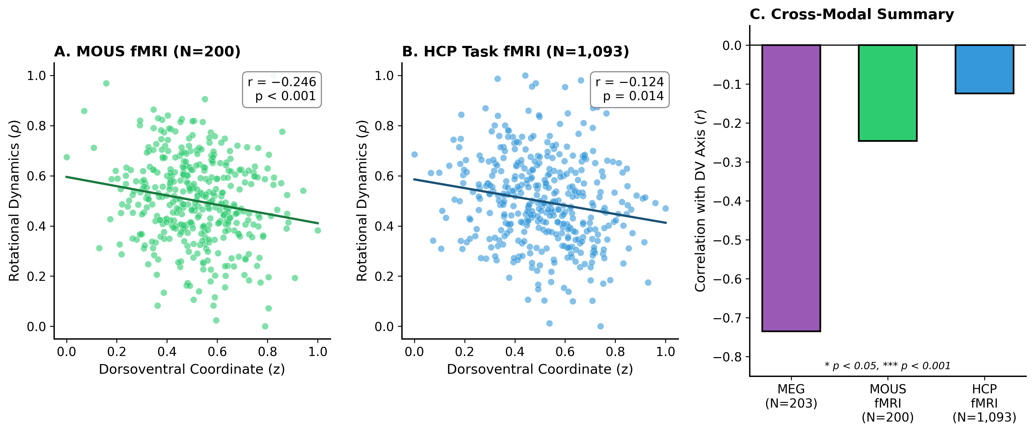

Slide 13
Figure 1 | A dorsoventral gradient of rotational dynamics in human cortex.a, Schematic of the computational pipeline. Local field potentials (or source-reconstructed MEG time series) are transformed into state-space trajectories via time-delay embedding (delay $d=1$). While projected here into 3 dimensions for visualization, the analysis utilizes a 10-dimensional state space. A linear vector autoregressive model (VAR) is fitted to the trajectory, and the resulting eigenvalues ($\lambda$) are plotted on the complex plane. The rotational dynamics index ($\rho$) is calculated based on the imaginary component of these eigenvalues (visualized as the angle relative to the real axis), where high $\rho$ indicates sustained oscillatory rotation and low $\rho$ indicates rapid decay.b, Cortical topography of rotational dynamics. Cortical surface map of $\rho$ across 400 parcels. The map reveals a pronounced spatial organization: ventral regions (temporal pole, orbitofrontal cortex; warm colors) exhibit high $\rho$, indicating strong rotational dynamics, while dorsal regions (superior parietal, somatomotor, dorsal premotor; cool colors) exhibit low $\rho$, indicating overdamped, stable dynamics.c, Quantification of the dorsoventral gradient. Scatter plot showing the strong negative correlation between the anatomical Z-coordinate (ventral-to-dorsal position) and rotational dynamics ($\rho$) across all cortical parcels ($r = -0.731$; manuscript reported $r = -0.735$, $p_{spin} = 0.002$). Each dot represents one parcel. The relationship is robust to parcellation resolution and individual variability.d, Independence from the principal functional gradient. Scatter plot of $\rho$ against the principal gradient of functional connectivity (Margulies et al., 2016). Unlike intrinsic timescales, rotational dynamics are orthogonal to the sensory-transmodal hierarchy ($r = -0.04$, $p = 0.45$). The grey dashed lines indicate the mean of each axis; the black line represents the linear fit. This dissociation implies that $\rho$ captures a distinct axis of cortical organization separate from hierarchical processing depth.

Slide 14
Figure 2 | Frequency-specific organization reveals a spectral trade-off.a, Differential spatial gradients across frequency bands. Correlation between rotational dynamics ($\rho$) and the dorsoventral axis across canonical frequency bands. A distinct spectral reversal is observed: slow rhythms (delta, theta) exhibit positive correlations (dorsal predominance), while fast rhythms (alpha through gamma) exhibit strong negative correlations (ventral predominance). The broadband gradient ($r = -0.735$) is driven largely by the dominance of fast oscillatory dynamics in ventral regions.b, Robustness to embedding methodology. Comparison of gradients derived from fixed embedding delays (solid bars) versus adaptive delays targeting a quarter-cycle phase advance at each band's center frequency (hatched bars). The direction and magnitude of the gradients remain consistent, confirming that the spectral trade-off reflects genuine circuit properties rather than sampling artifacts associated with fixed delays.c, Cortical topography of slow versus fast dynamics. Surface visualizations of $\rho$ computed specifically for the delta band (1–4 Hz, left) and gamma band (30–40 Hz, right). Delta dynamics are strongest in dorsal parietal and motor cortices, potentially supporting large-scale integration, whereas gamma dynamics are concentrated in ventral temporal and orbitofrontal regions, consistent with local processing requirements for feature binding.

Slide 15
Figure 3 | Task-state robustness, cross-modal replication, and dissociation from intrinsic timescales.a, Replication across cognitive states. The dorsoventral gradient of rotational dynamics is not state-dependent. Scatter plots show the relationship between $\rho$ and dorsoventral position during a visual object recognition task ($N = 69, r = -0.684$) and an auditory speech processing task ($N = 95, r = -0.739$). The stability of the gradient suggests it reflects an underlying structural or circuit constraint rather than transient functional modulation.b, Dissociation from intrinsic timescales via spatial residualization. Scatter plot of the residuals of intrinsic timescales ($\tau$) versus rotational dynamics ($\rho$) after regressing out spatial coordinates ($x, y, z$). While raw metrics show little correlation, their residuals exhibit a strong anticorrelation ($r = -0.650$). This implies a local trade-off: within a given cortical neighborhood, circuits cannot simultaneously maximize temporal integration (long $\tau$) and oscillatory rotation (high $\rho$).c, Cross-modal validation in fMRI. Replication of the dorsoventral gradient using resting-state fMRI in the MOUS dataset ($N = 200; r = -0.246, p_{spin} < 0.001$) and task-state fMRI in the independent Human Connectome Project dataset ($N = 1,093; r = -0.124, p_{spin} = 0.014$). Despite the low temporal resolution of BOLD signals, the gradient is detectable when broadband signal fluctuations are preserved.Figure 4 | Proposed circuit mechanisms and functional implications.a, Hypothesis of inhibitory interneuron gradients. Schematic illustrating the putative cellular basis of the gradient. Ventral regions (high $\rho$) are hypothesized to be enriched in parvalbumin-positive (PV) interneurons, which generate fast gamma oscillations and rotational dynamics through perisomatic inhibition. Dorsal regions (low $\rho$) may rely more on somatostatin-positive (SST) interneurons and recurrent excitation that favors slow integration and stable, point-attractor dynamics.b, Alignment with dual-stream cortical processing. The gradient of rotational dynamics parallels the functional segregation of the visual system. The ventral "what" stream (red arrow) aligns with high rotational dynamics, supporting the dynamic binding of features over time. The dorsal "where/how" stream (blue arrow) aligns with stable, decaying dynamics, supporting spatial coordinate transformations and action guidance.

Slide 16
Extended Data Fig. 1 | Quality control of linear model fitting.Histogram of $R^2$ values for the vector autoregressive (VAR) models fitted to delay-embedded time series across all 400 parcels. The median $R^2$ is 1.000 (range $> 0.9998$), indicating that the local dynamics are well-approximated by linear autoregressive processes in the embedded state space.Extended Data Fig. 2 | Reliability of intrinsic timescale estimation.Split-half reliability plot for intrinsic timescales ($\tau$). The correlation between $\tau$ estimates derived from the first half and second half of the participant pool is extremely high ($r = 0.982$), confirming that the metric captures stable, group-level properties of cortical dynamics.Extended Data Fig. 3 | Null distribution for HCP replication.Results of the spin permutation test for the Human Connectome Project (HCP) MEG replication (gamma-low band). The histogram shows the null distribution of correlation coefficients generated by 10,000 spatial permutations (spin tests). The observed correlation ($r = -0.399$, red dashed line) falls at the edge of the distribution ($p_{spin} = 0.115$, two-tailed), indicating a consistent trend despite the methodological differences in using power envelope data.Extended Data Fig. 4 | Independence of intrinsic timescales from spatial axes.Scatter plot of intrinsic timescales ($\tau$) against the anterior-posterior (AP) axis. While there is a weak positive trend ($r = 0.351$), this relationship does not survive spatially constrained null models ($p_{spin} = 0.229$). A similar null result was found for the dorsoventral axis ($r = -0.345, p_{spin} = 0.234$), confirming that $\tau$ does not follow the simple geometric gradients observed for $\rho$.

Slide 17
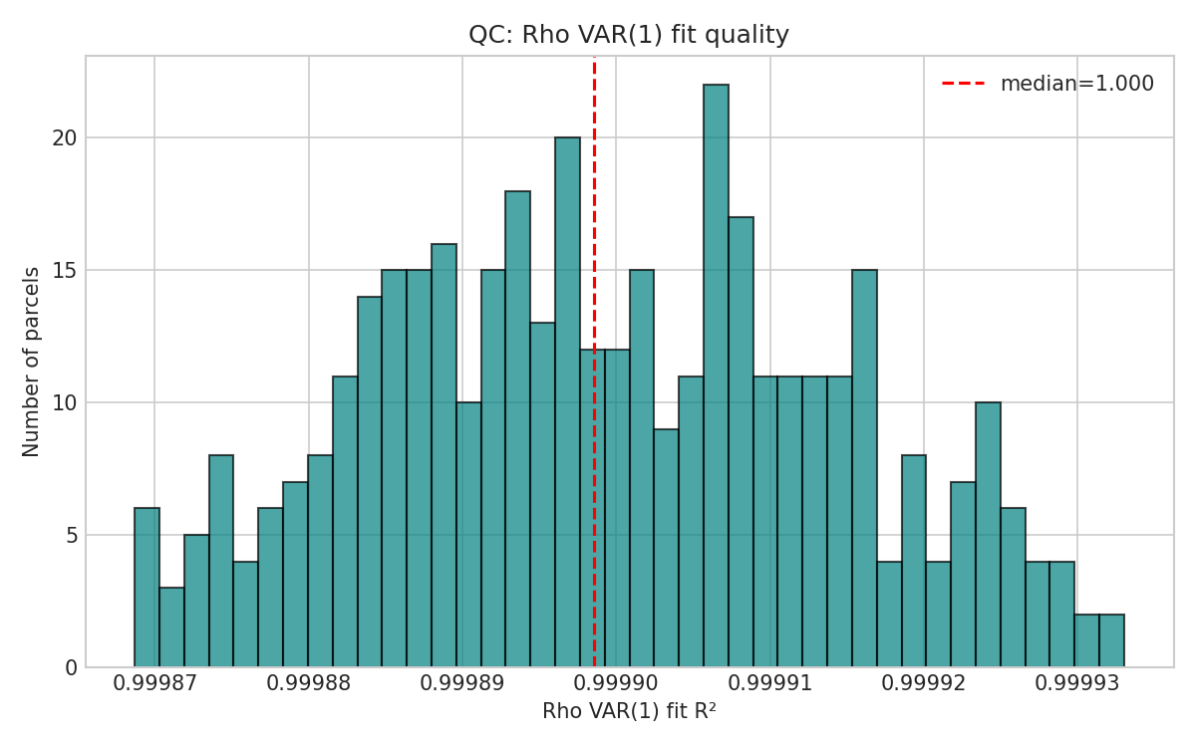

Slide 18
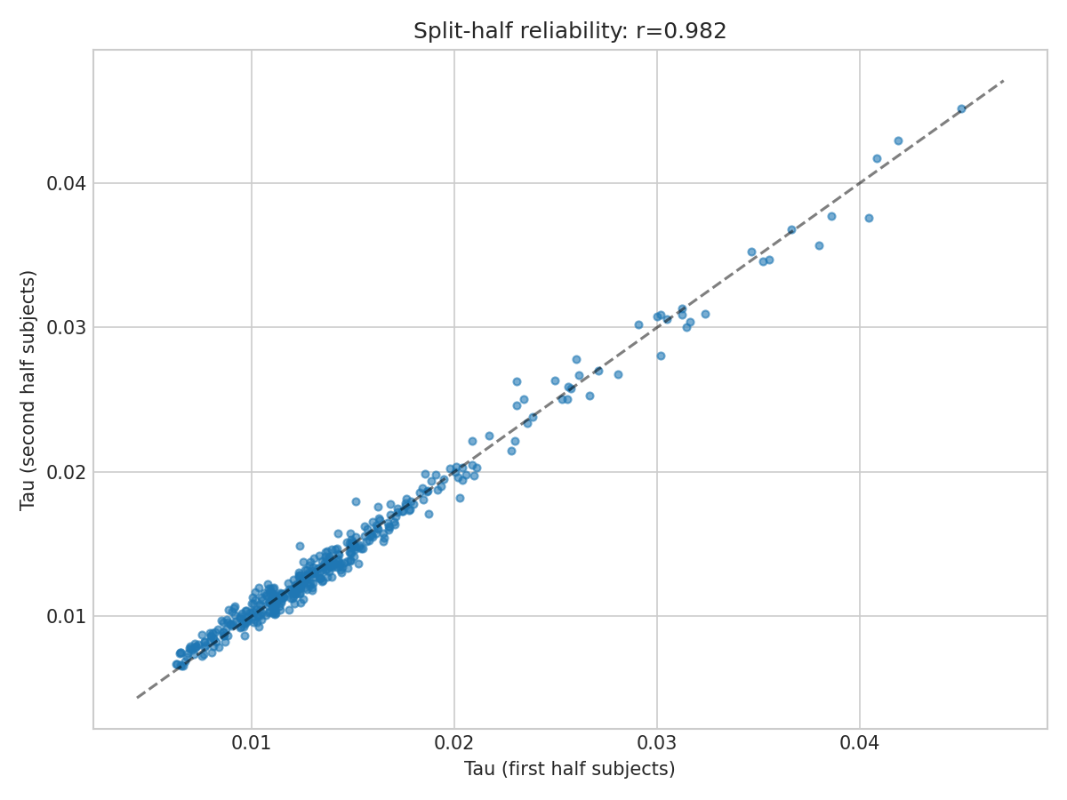

Slide 19
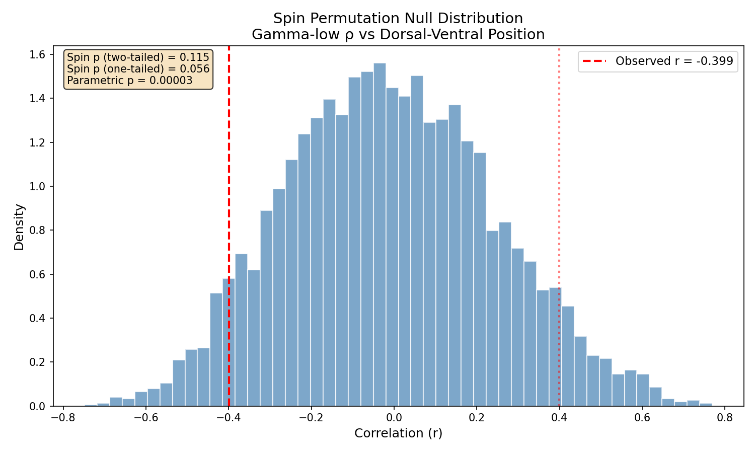

Slide 20
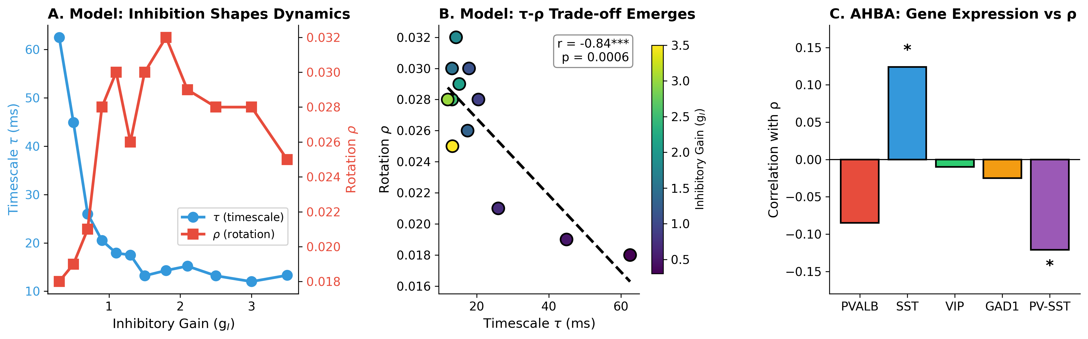

Slide 21
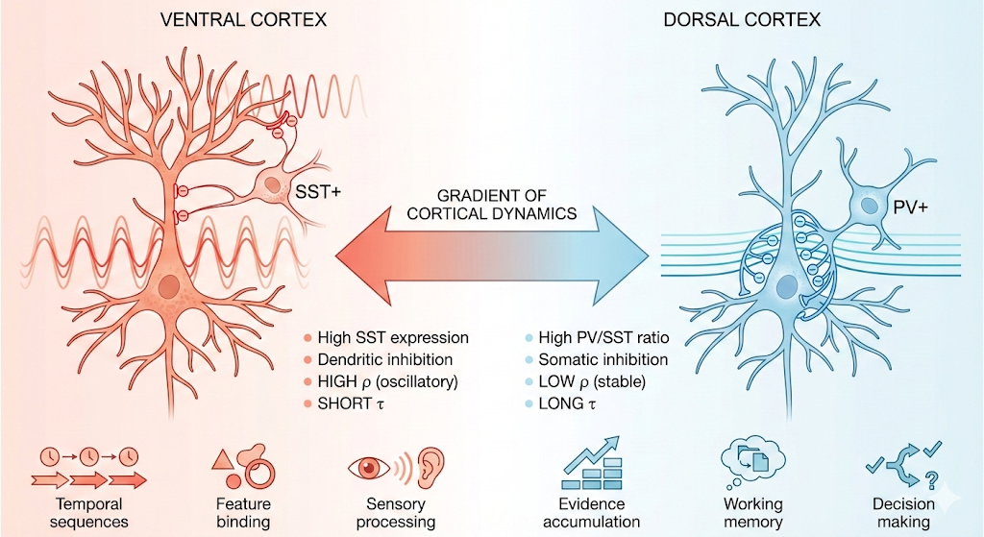

Slide 22
Figure 6 Caption:
Figure 6. Computational modeling and gene expression reveal mechanistic basis of the ρ gradient.
(A) Rate-based excitatory-inhibitory network model demonstrates that varying inhibitory gain (g_I) produces opposing effects on intrinsic timescale τ (blue circles, left axis) and rotational dynamics ρ (red squares, right axis). Strong inhibition (high g_I) produces fast dynamics with high rotation; weak inhibition produces slow, stable dynamics.
(B) The τ-ρ trade-off emerges naturally from E-I balance (r = −0.84, p < 0.001). Each point represents a network simulation; color indicates inhibitory gain. Dashed line shows linear fit.
(C) Allen Human Brain Atlas gene expression correlations with ρ. SST (somatostatin) shows significant positive correlation with ρ (r = +0.12, p = 0.02), while PVALB (parvalbumin) is non-significant. The PV-SST difference correlates negatively with ρ (r = −0.12, p = 0.02), indicating that high PV/SST ratio predicts low rotational dynamics. *p < 0.05, **p < 0.01.
(D) Revised mechanistic model based on computational and gene expression findings. Ventral cortex (left, warm colors): high SST expression provides dendritic inhibition that gates input timing and creates oscillatory dynamics (high ρ, short τ), suited for sequence generation and feature binding. Dorsal cortex (right, cool colors): high PV/SST ratio provides somatic inhibition that stabilizes activity (low ρ, long τ), suited for evidence accumulation and working memory.

